Slide 1
Digital Portfolio
STUDENT NAME : Udhaya S
REGISTER NO : 20324U09095
NMID : F7DD27C793D24799C8E4934D48D06335
DEPARTMENT : BCA
COLLEGE : Dr. M.G.R. Chokkalingam Arts COLLEGE
UNIVERSITY. : THIRUVALLUVAR UNIVERSITY

Slide 2
PROJECT TITLE
Digital portfolio Using front end development

Slide 3


AGENDA
Problem Statement
Project Overview
End Users
Tools and Technologies
Portfolio design and Layout
Features and Functionality
Results and Screenshots
Conclusion
Github Link
3/21/2024 Annual Review

Slide 4

PROBLEM STATEMENT
The objective was to create a personal portfolio website to professionally showcase Udhaya S’s skills, projects, and personal background.
The site aims to be visually engaging, user-friendly, and easily navigable to leave a lasting impression on visitors.
It should effectively communicate the developer’s passion for web development.
The design must be simple yet modern to appeal to a broad audience.
The project also needed to incorporate basic interactivity for enhanced user experience.

Slide 5

PROJECT OVERVIEW
This project is a single-page portfolio website developed for Udhaya S, a student learning web development.
It features a fixed navigation bar for easy access, a visually appealing hero section with a call-to-action, and an about section to highlight personal details.
The site is designed to be clean and professional, with a focus on simplicity.
It serves as a foundation for showcasing future projects and skills.
The portfolio is extensible for additional sections like projects or contact forms.

Slide 6

WHO ARE THE END USERS?
Potential employers or recruiters seeking to evaluate technical skills and project experience.
Peers or collaborators interested in exploring Udhaya S work and potential partnerships.
General visitors curious about personal projects or seeking inspiration.
Academic mentors or peers reviewing the portfolio for feedback.
Clients or freelancers looking for a developer with a passion for web development.

Slide 7

TOOLS AND TECHNIQUES
HTML: Provides the core structure for organizing content on the website.
CSS: Manages styling, including layouts, color schemes, and responsive design elements.
JavaScript: Enables smooth scrolling functionality for seamless navigation.
VS Code: Used as the primary code editor for writing and managing code.
Browser DevTools: Employed for debugging, testing, and ensuring cross-browser compatibility.

Slide 8
POTFOLIO DESIGN AND LAYOUT
Navbar: Fixed header with a dark background, bold white logo, and navigation links (Home, About) for easy access.
Hero Section: Full-height section with a vibrant blue gradient background, centered text, and a prominent call-to-action button.
About Section: Minimalistic layout featuring a heading, placeholder profile image, and a concise bio about the developer.
Design Aesthetics: Clean and modern, with a dark Navbar contrasting the lively hero section for visual impact.
Responsiveness: Designed with a viewport meta tag to ensure compatibility across mobile and desktop devices.
8

Slide 9
FEATURES AND FUNCTIONALITY
Navigation: Links to Home and About sections with smooth scrolling powered by JavaScript for a polished experience.
Hero Section: Displays Udhaya S name, a tagline emphasizing passion for web development, and a “View My Work” button.
Responsive Design: Incorporates a viewport meta tag and flexible CSS to adapt to various screen sizes.
Interactivity: Smooth scrolling to the About section enhances user engagement and navigation flow.
Extensibility: Structured to easily accommodate future additions like project showcases or contact forms.

Slide 10
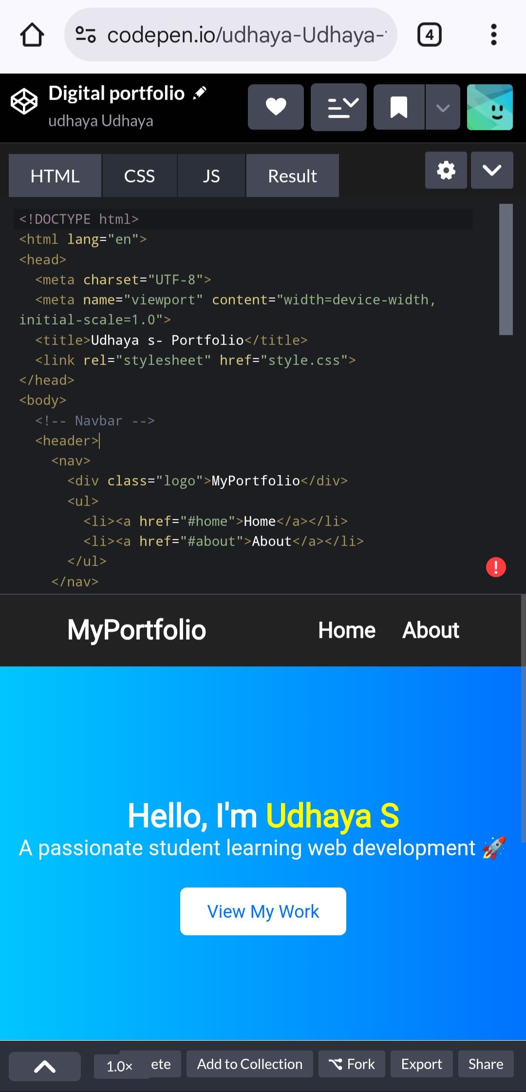
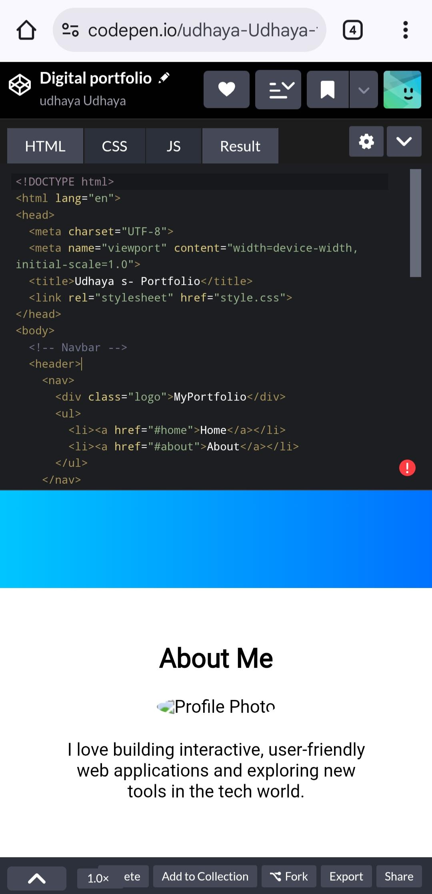

RESULTS AND SCREENSHOTS
3/21/2024 Annual Review
10

Slide 11
CONCLUSION
The portfolio successfully presents Udhaya S’s identity and passion for web development in a professional manner.
Its clean design, smooth navigation, and responsive layout make it effective for its purpose.
The site serves as a strong foundation for showcasing future projects and skills.
It is user-friendly and adaptable for enhancements like project galleries or interactive forms.
Overall, it meets the goal of creating an impactful online presence.
11

Slide 12
GitHub link
https://udhaya20324u09095-glitch.github.io/TNSDC-FWTDD-DigitalPortfolio/

